Slide 1
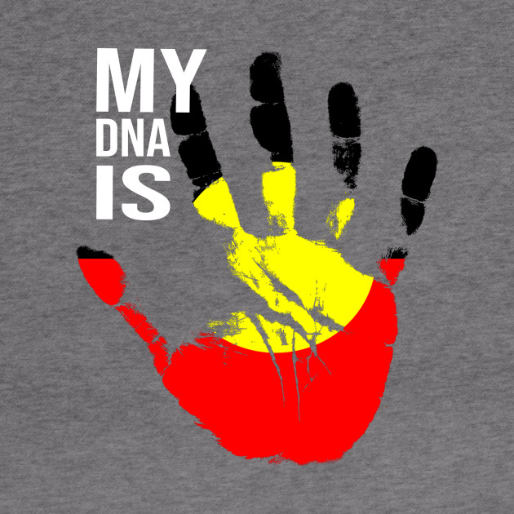
BODY ART FOR NAIDOC WEEK
By Presley

Slide 2


Slide 3
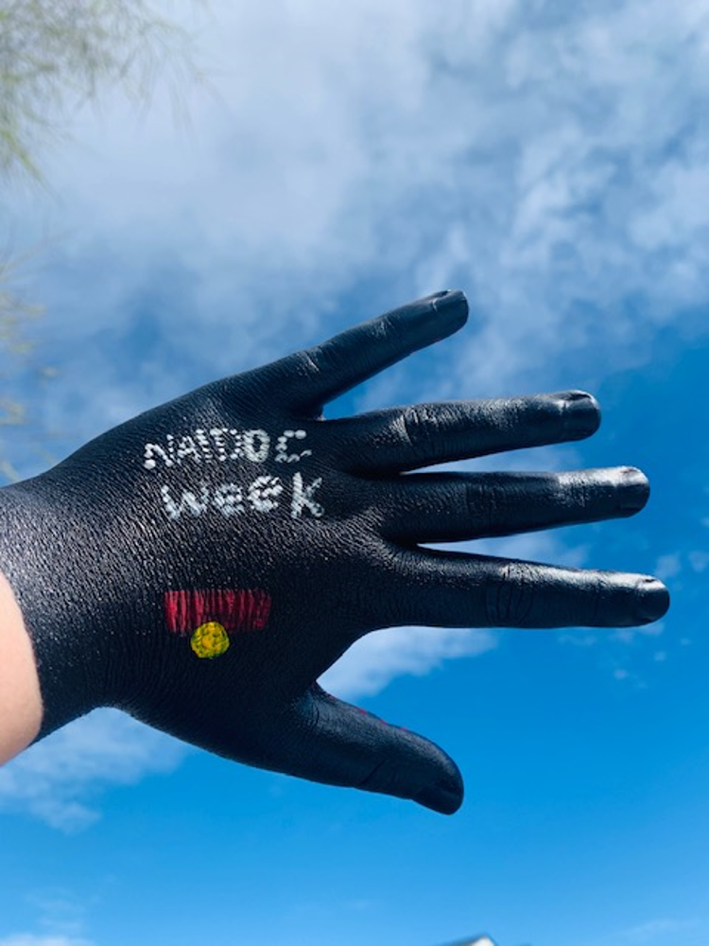
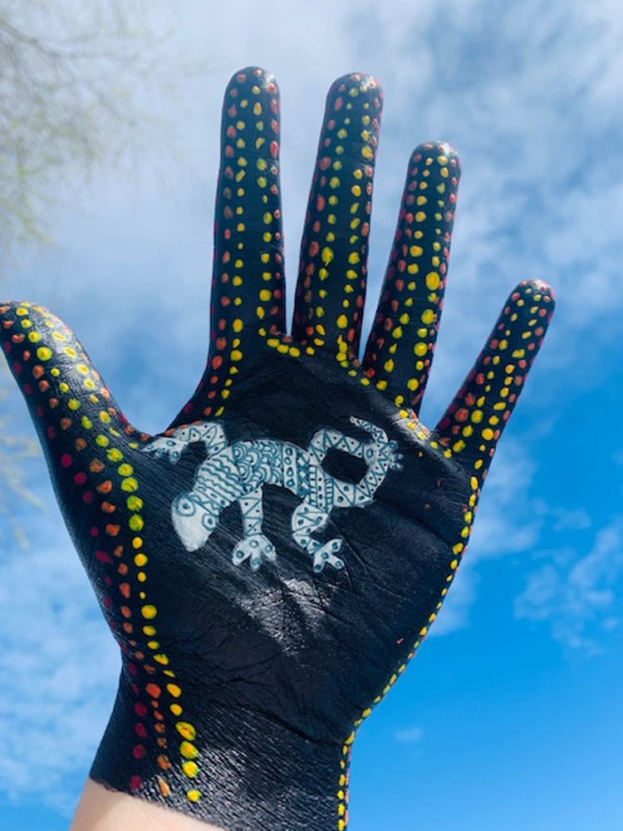

Slide 4
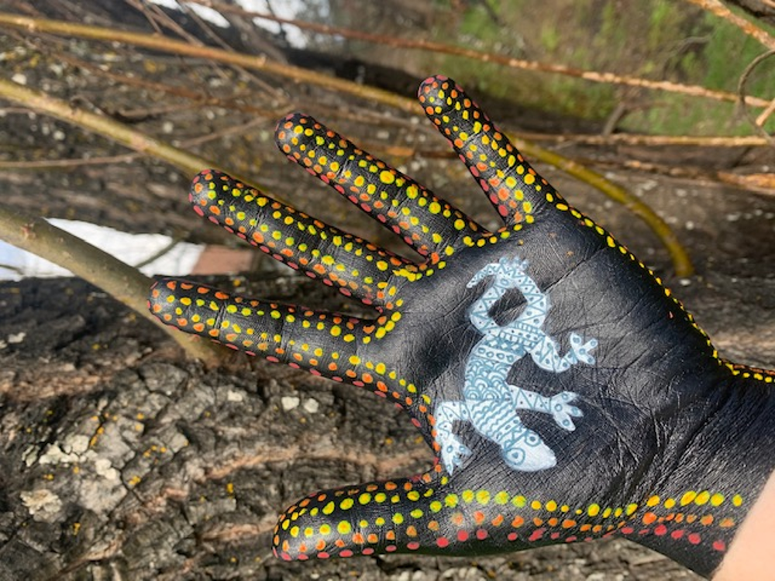
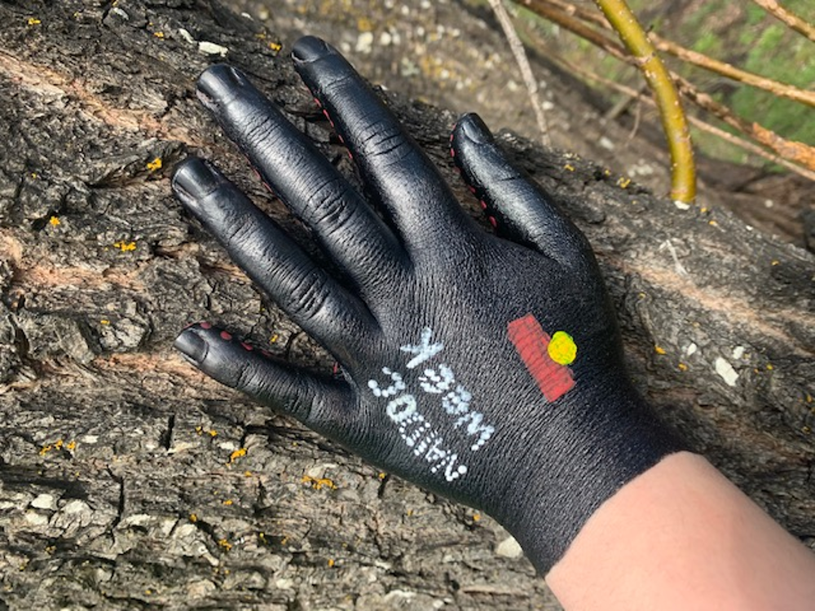

Slide 5
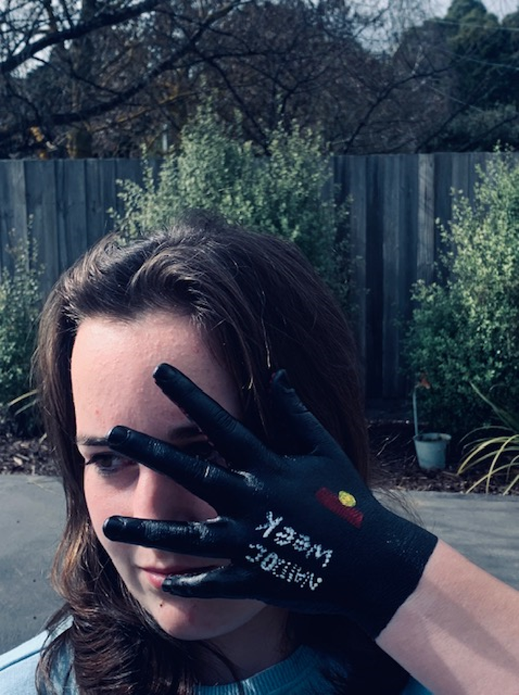
ALWAYS WAS, ALWAYS WILL BE
NAIDOC week is a celebration of the history
Culture and achievements of Aboriginal and
Torres Strait Islander people. This year to celebrate
Indigenous culture I have chosen to do some Body Art.

